Slide 1


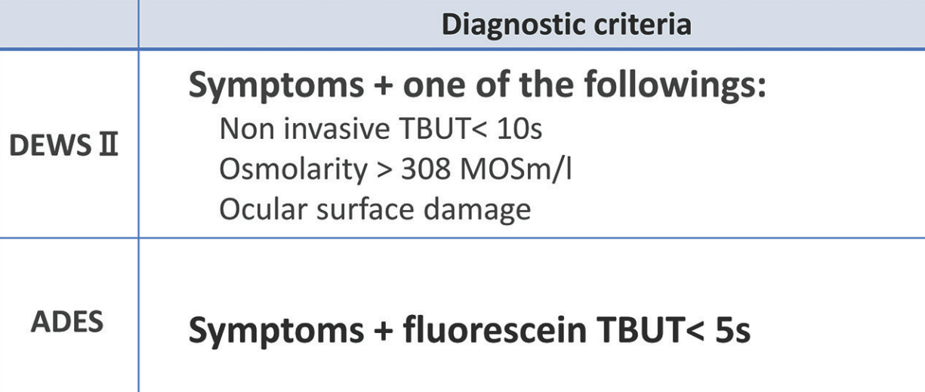
乾眼症的診斷與分類
OSDI
OCI, OSDI, DEQS,…
Indian J Ophthalmol. 2022 Jun;70(6):1883-1891. doi:10.4103/ijo.IJO_1804_21.
Notes:
日本診斷主要依據可見的異常如BUT及SPK，認為發炎是乾眼症所造成的結果而不是主要因素
美國等地則是依據相對較不直觀的異常如淚液滲透壓、發炎

Slide 2
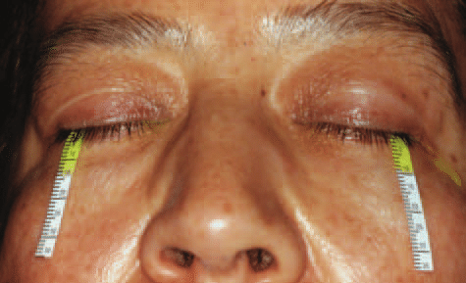
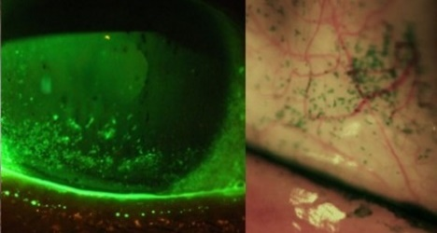
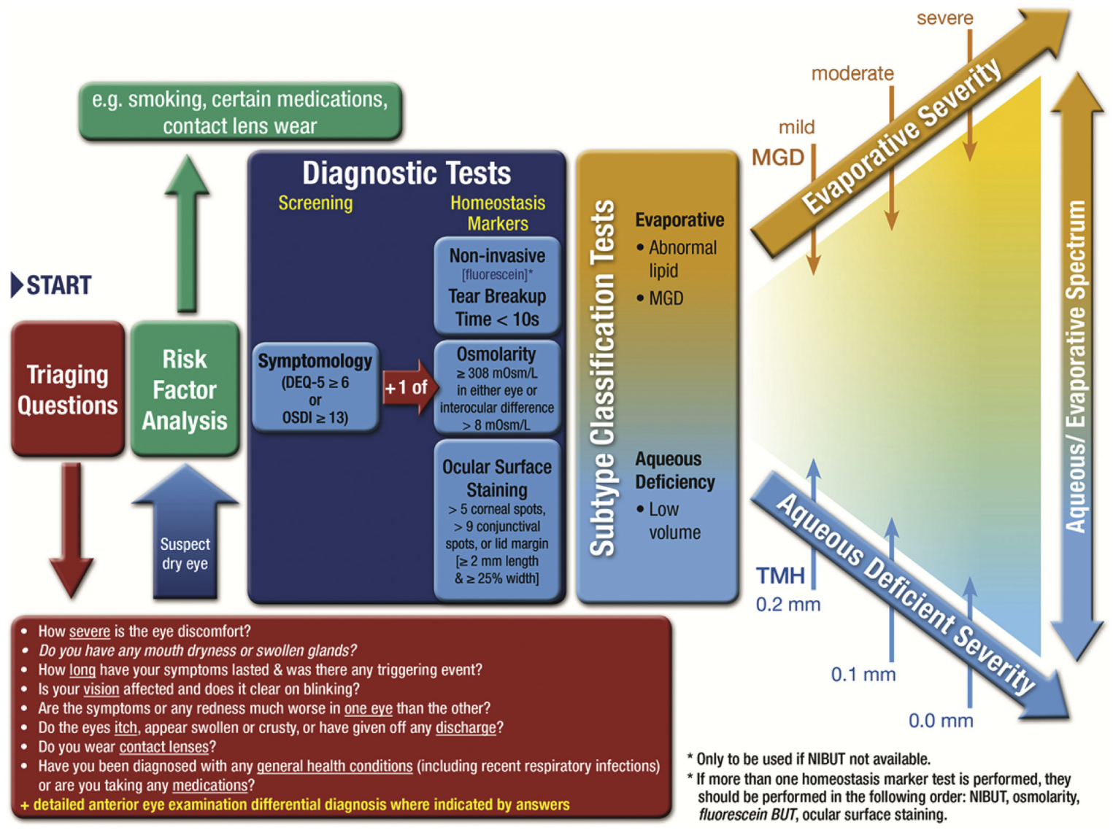
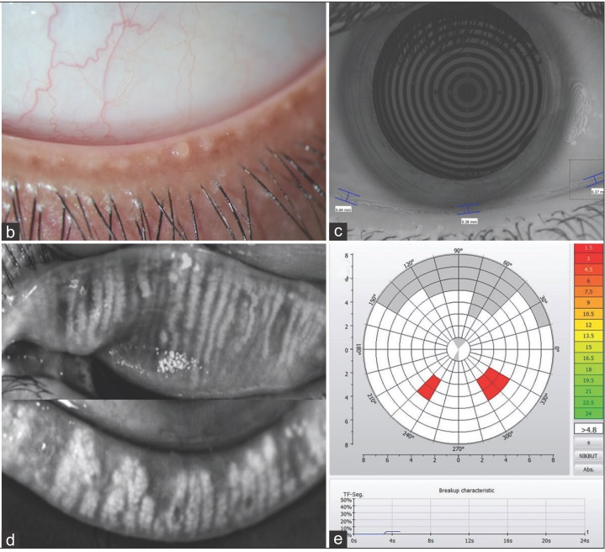
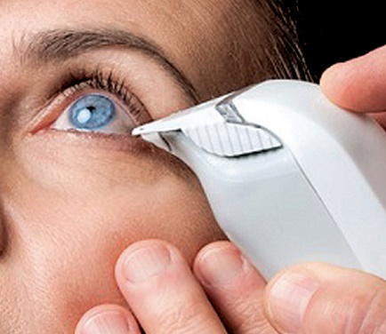
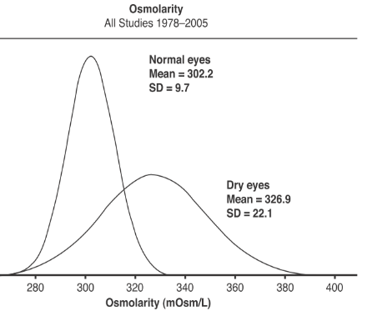
乾眼症的診斷 (TFOS DEWS II 2017)
Ocul Surf. 2013 Oct;11(4):246-58. doi:10.1016/j.jtos.2013.07.003.
Ocul Surf. 2017 Jul;15(3):544-579. doi:10.1016/j.jtos.2017.05.001.
Notes:
Fig. 3. At left, TearLab’s osmometer collects a liquid sample at the outermost area of the lateral tear meniscus. The I-Pen, at right, gathers a sample with approximately two to five seconds of contact with the tear-soaked palpebral conjunctiva. Images: Srihari Narayanan, OD, PhD; I-Med

Slide 3

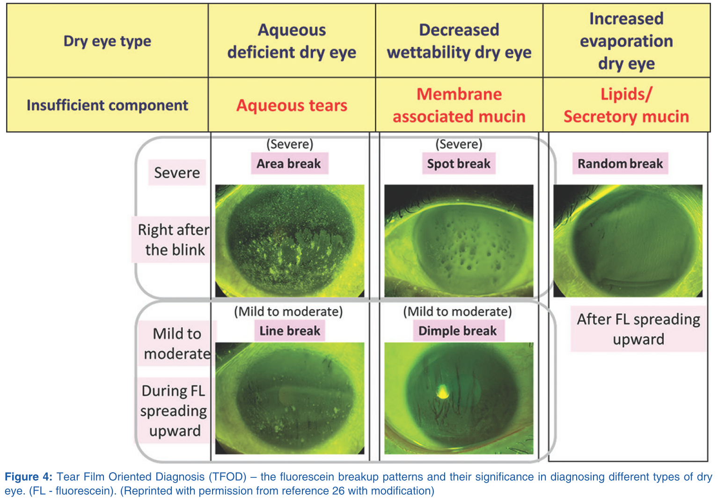
乾眼症的診斷 (ADES TFOD 2017)
Indian J Ophthalmol. 2022 Jun;70(6):1883-1891. doi:10.4103/ijo.IJO_1804_21.
Notes:
AEDS 主要評估淚膜穩定度，淚液崩解時間過短與明顯症狀就可診斷為乾眼症
但是sTBUT並不能代表乾眼的嚴重度或是分類的依據，由此概念衍生出TFOD(診斷)與TOFT(治療)
利用淚膜的分布狀態來分類屬於缺水型ADDE、濕潤不足型DWDE、或是揮發型(缺油型)EDE

Slide 4
乾眼症的治療

Slide 5
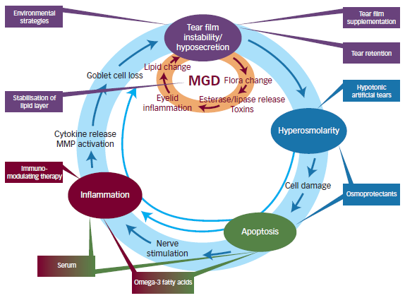
淚膜不穩
分泌過少
滲透壓
上升
發炎
細胞
凋亡

Slide 6
DEWS II Staged Management & Treatment
Step 1
Education, environmental and dietary modifications (omega-3 FA)
Elimination of offending topical/systemic medications
Step 2
Non-preserved lubricants
Ointment
Tea-tree oil wipe for Demodex
Step 3
Oral secretagogues
Step 4
Topical corticosteroid (longer duration)
Amniotic membrane grafts
Surgical punctal occlusion
Other surgical approaches (e.g. tarsorrhaphy, salivary gland transplantation)
Ocular lubricants (lipid-containing supplements if MGD presents)
Lid hygiene and warm compress
MG expression (manual, LipiFlow)
Topical secretagogues
Topical Immunomodulator (CsA, LFA-1 antagonist)
Oral macrolide/tetracycline
Punctual occlusion
IPL
Topical steroids (limited duration) or Abx/steroid for blepharitis
Autologous/allogeneic serum eye drops
Therapeutic CL (soft bandage lenses, rigid scleral lenses)
Ocul Surf. 2017 Jul;15(3):575-628. doi:10.1016/j.jtos.2017.05.006.

Slide 7
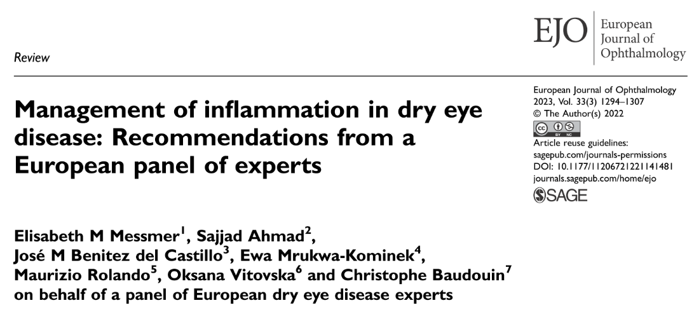
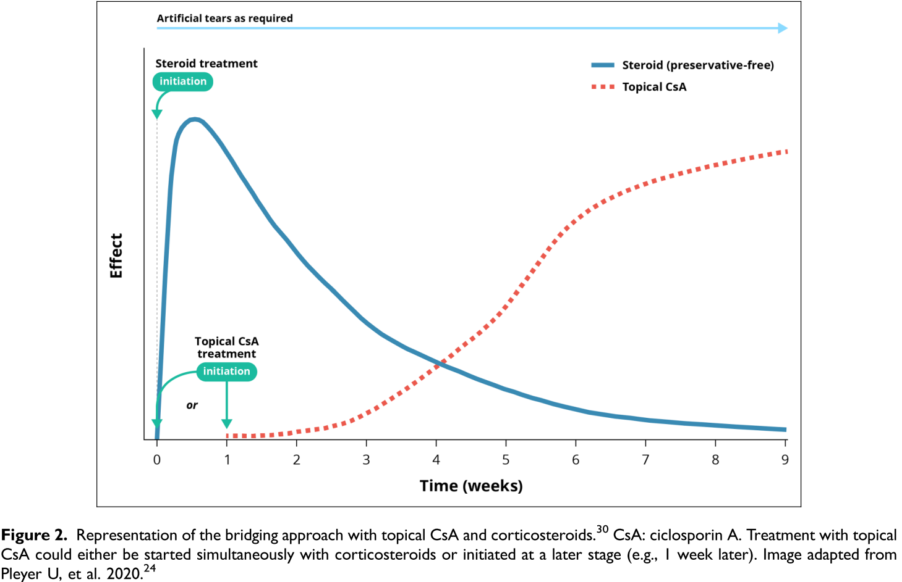
Eur J Ophthalmol. 2023 May;33(3):1294-1307. doi: 10.1177/11206721221141481.
Notes:
Eur J Ophthalmol. 2023 May;33(3):1294-1307. doi: 10.1177/11206721221141481.
CsA的效果通常在6-8周時會較顯著，並在持續治療三至六個月後會更加改善
在點用CsA前15-20分鐘先點人工淚液，可以減緩點CsA造成的灼熱刺痛感
Administration of ATs 15 – 20 min before and/or after administration of CsA leads to significant improvements in the symptoms of burning, stinging and irritation previously experienced with CsA instillation.
以短期類固醇使用作為使用CsA的橋接治療方式是可行的
Initiating short-term treatment with corticosteroids at the same time or shortly before starting topical CsA therapy (bridging) leads to good outcomes.

Slide 8
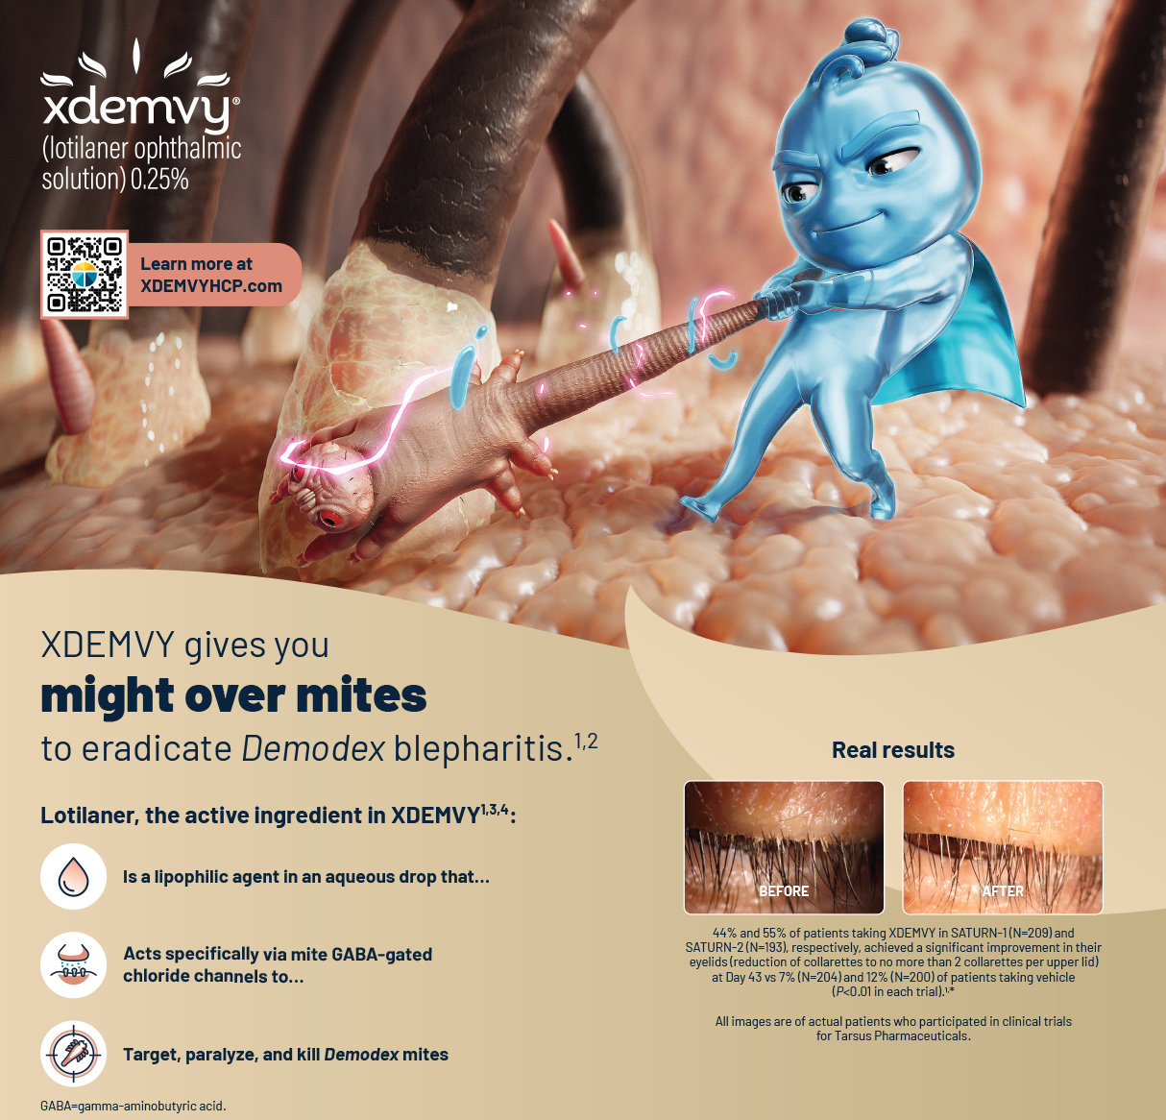
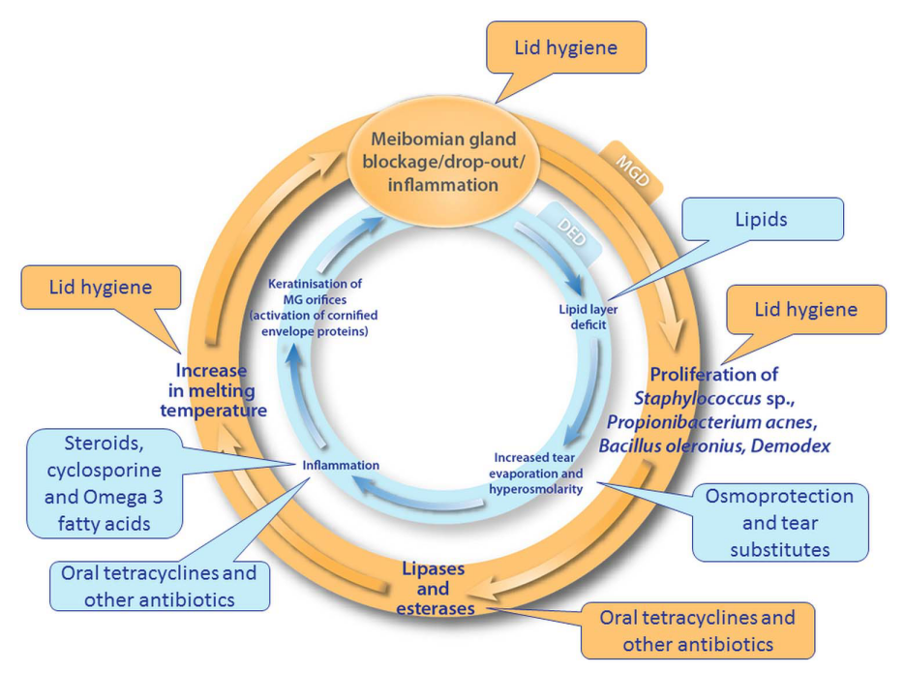
瞼板腺功能障礙的治療方式
Br J Ophthalmol 2016;100:300–306. doi:10.1136/bjophthalmol-2015-307415.
Notes:
去年美國FDA核准；然而目前國內含lotilaner成分的藥物只有貓狗抗寄生蟲口服藥，並無液體劑型或是眼藥型式。
10cc裝劑型0.25% lotilaner藥水，美國售價約為$1850~2000美金

Slide 9
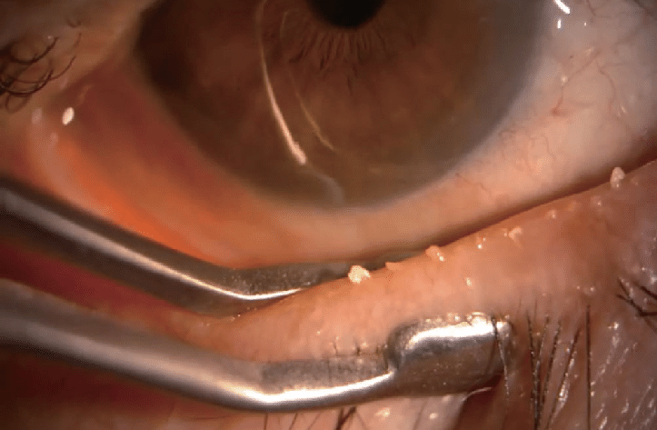
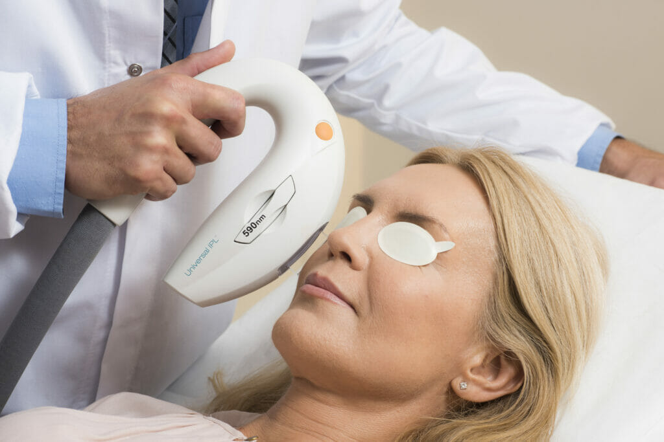
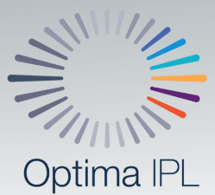
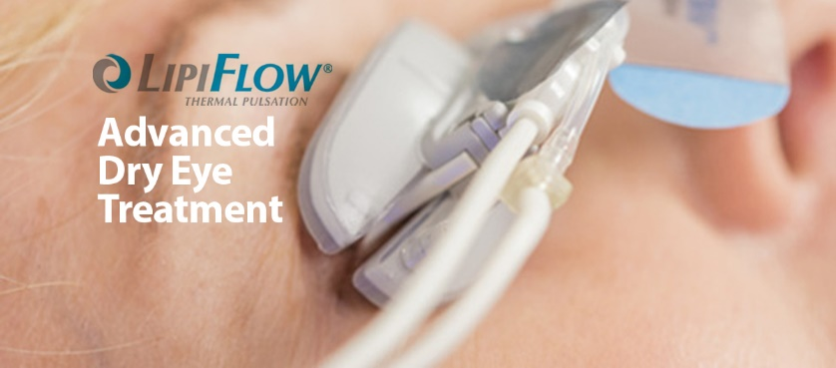
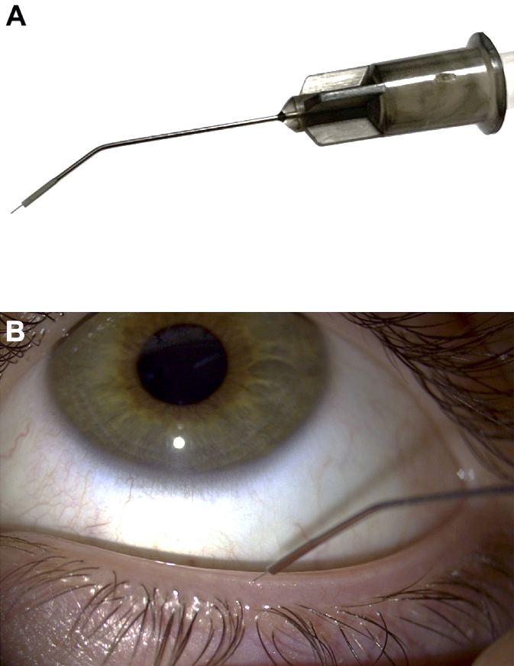
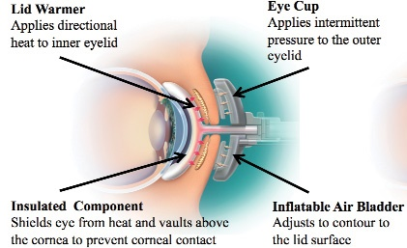

瞼板腺功能障礙的治療方式
Manual MG expression
Intraductal MG probing
Indian J Ophthalmol. 2023 Apr;71(4):1348-1356. doi:10.4103/IJO.IJO_2841_22.
Notes:
The melting point of meibum increases in MGD (35°C) as compared to non‑MGD (32°C) because of its altered lipid composition.
The obstruction of ducts with thick meibomian secretions leads to a stagnant and less dynamic tear film.

Slide 10
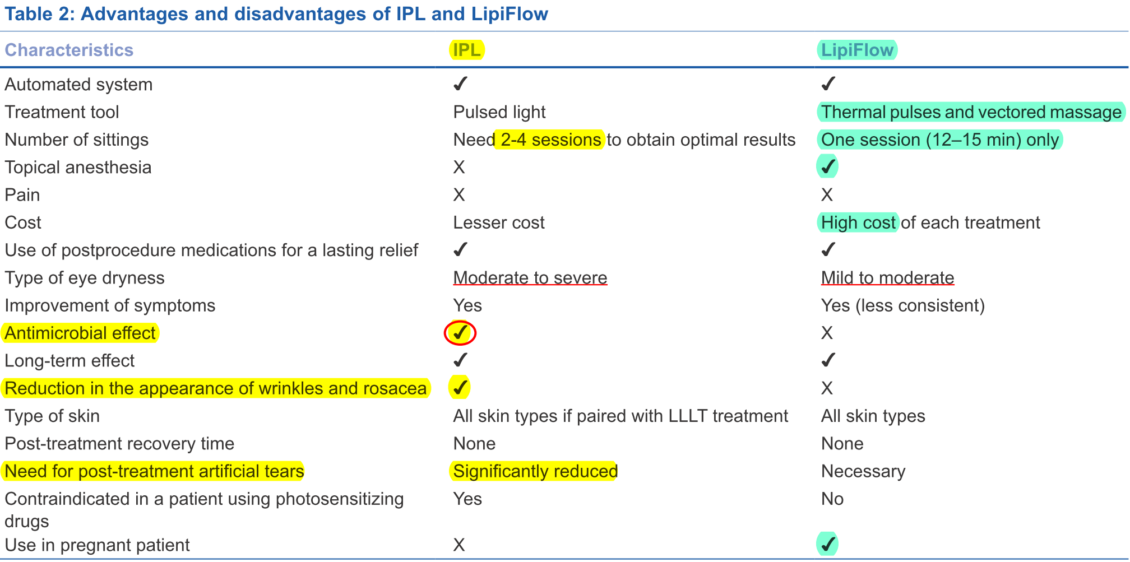
脈衝光與熱脈動治療的比較
Indian J Ophthalmol. 2023 Apr;71(4):1348-1356. doi:10.4103/IJO.IJO_2841_22.

